Slide 1
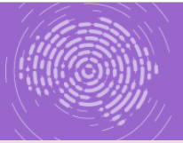
Nikolay Korotaev RSUH, Institute of Linguistics RAS, Moscow
QUESTIONS AND SEMI-STATEMENTS IN MULTICHANNEL DISCOURSE
Project #14-18-03819
The VII International Conference on Cognitive Science
Svetlogorsk, October 20th 2018

Slide 2
Coordination in multichannel communication
Interpersonal
Inter-channel
Aspects of coordination (see Loehr 2012)
temporal
pragmatic
structural
Possible research programs
searching for an overall coordination (Kendon 1967, McNeill 1992, Mondada 2014a, Фёдорова и др. 2016)
focusing on specific contexts (Seyfiddinipur 2006, Oloff 2012, Mondada 2014b, Akhavan et al 2016)

Slide 3
In this talk
Pragmatic and structural (rather than temporal) interpersonal and inter-channel coordination in a specific context – that of elicitation (see Chafe 1994)
Fixed roles:
The eliciter formulates a request for information
The responder(s) provide(s) the requested information

Slide 4
Data
Russian Pear Chats and Stories (Кибрик 2018; http://multidiscourse.ru/)
Conversation stage:
The Reteller recurrently initiates elicitation so that (s)he later perform the Retelling stage
Narrator
Reteller
Commentator
Three sessions (summer 2015, ~ 30 mins of conversation)

Slide 5
Task
Detecting standard patterns of elicitation as they arise in natural multichannel communication
What the Reteller, the Narrator and the Commentator say and do when the Reteller initiates an elicitation sequence

Slide 6
Annotation
Original multichannel annotation provided by
Vera I. Podlesskaya
Nikolay A. Korotaev
Olga V. Fedorova
Alla O. Litvinenko
Yulia V. Nikolaeva
Additional annotation for this specific study

Slide 7
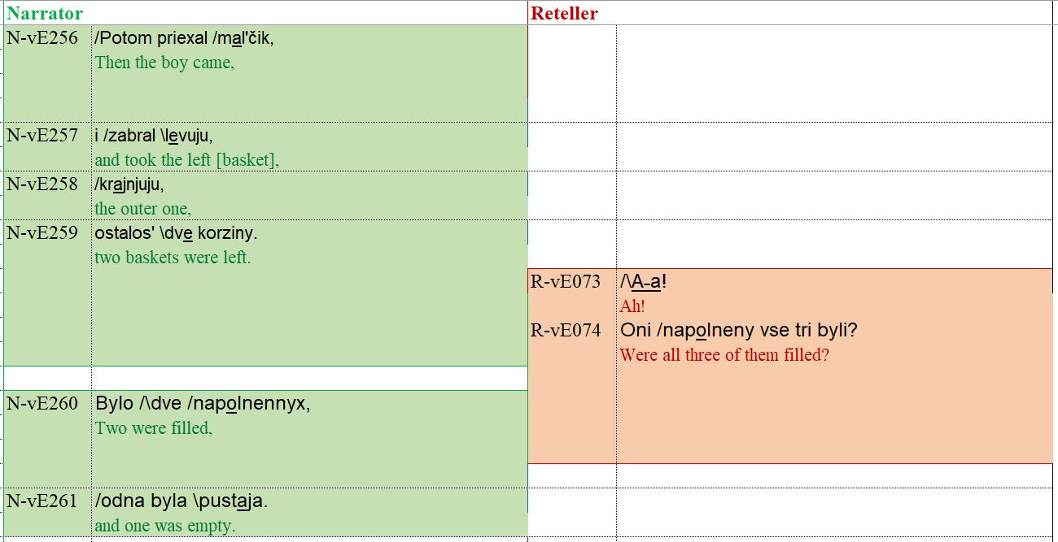
Option 1: QUESTION

Slide 8
Example 1: Question

Slide 9
Example 1: Question
Rising pitch accent
Oni /napolneny vse tri byli? they filled all three were
Kinetic support
Manual and cephalic movements towards the Narrator
The responder reacts with an answer
Adjacency pair

Slide 10
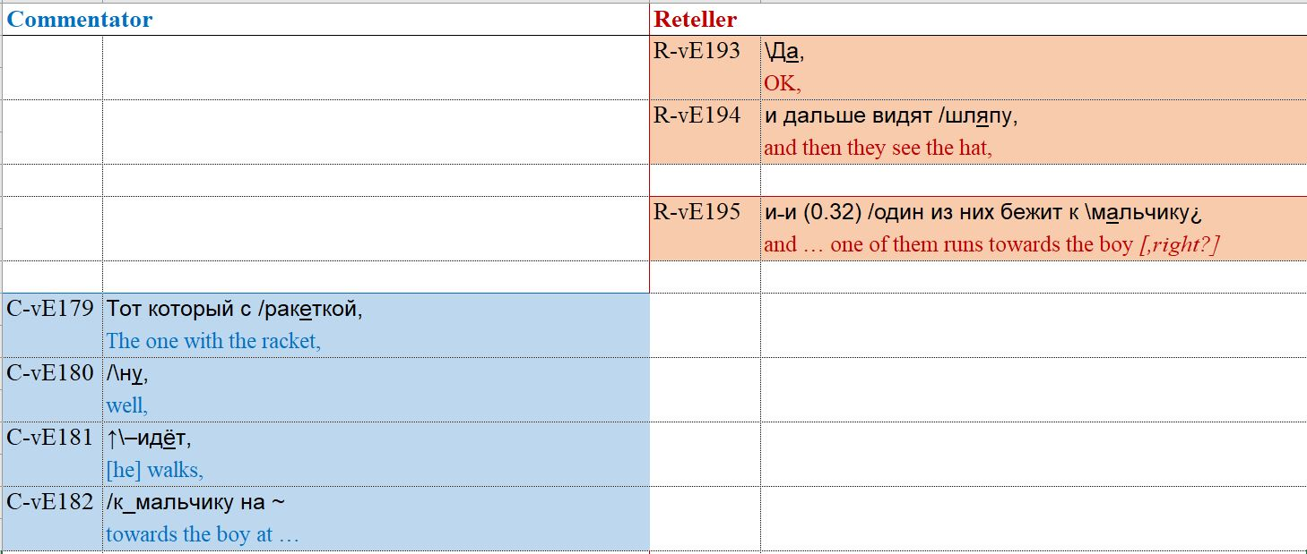
Option 2: SEMI-STATEMENT

Slide 11
Example 2: Semi-statement

Slide 12
Example 2: Semi-statement
Falling pitch accent (as in statements)
i /odin iz nix bežit k \mal’čiku¿ and one of them runs towards the.boy
But still initiates an elicitation!
Kinetic support
Manual gesture with a long retraction
The responder reacts
with a confirmation / refutation / clarification

Slide 13
Questions and semi-statements
In our data:
68 sequences initiated with questions
38 sequences initiated with semi-statements
Next:
patterns of elicitation (without distinction between questions and semi-statements)
comparison of questions and semi-statements with regard to the detected patterns

Slide 14
Next speaker allocation
Sacks et al. 1974 Rule 1:
the current speaker selects the next speaker
102 out of 106 instances in our data have a clear indication of who is to speak next
The key marker is gaze direction

Slide 15
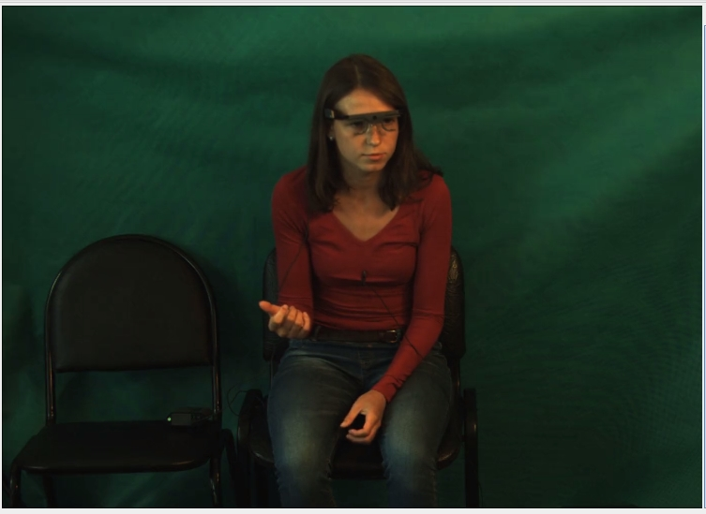
Example 2: Reteller looks at Narrator

Slide 16
Gaze direction IS important
Retellers tend to wait until the selected participant reacts (see later on immediate vs. delayed reactions)
“Wrong” gaze direction may cause speech repairs

Slide 17
Two further parameters
The reaction of the selected participant may be:
Immediate
Delayed (after the third participant provides her reaction)
None
The Reteller may or may not provide an acceptance signal
vocal (Ponjatno ‘Got it’; Aga ‘OK’), and / or
cephalic – a (series of) nod(s)

Slide 18
The base pattern
The Reteller selects the next speaker
The selected participant provides an immediate or a delayed reaction
The Reteller provides an acceptance signal
52 out of 106 instances, 49.1%

Slide 19
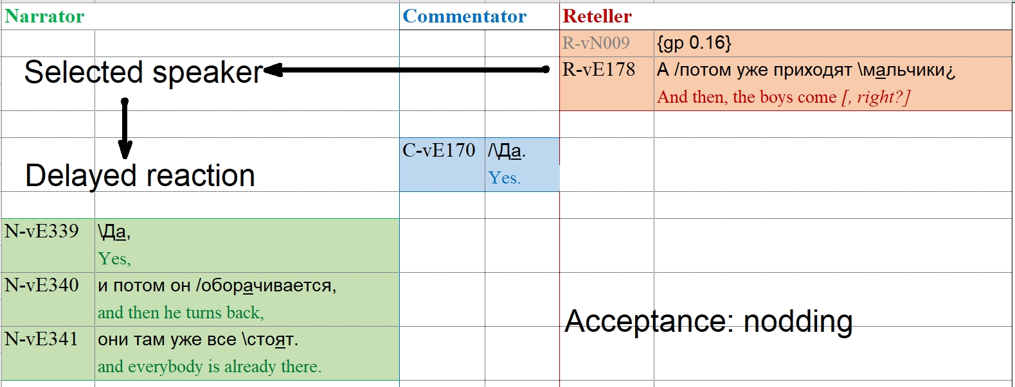

Slide 20
The base pattern

Slide 21
The unfinished pattern
The Reteller selects the next speaker
The selected participant provides an immediate or a delayed reaction
The Reteller DOES NOT provide an acceptance signal
Instead, (s)he initiates a NEW elicitation sequence – thus, expands the current context
25 out of 106 instances, 23.6%

Slide 22
The unrealized pattern
The Reteller selects the next speaker
The selected participant DOES NOT react
The Reteller DOES NOT provide an acceptance signal (even if the third participant reacts instead of the selected one)
Rather, the Reteller repeats the original request…
or gives up
13 out of 106 instances, 12.3%

Slide 23
Questions vs. semi-statements: distribution of patterns
No significance (chi-square: p = 0.15; Fisher exact test Base vs. Non-base: p = 0.85)
X

Slide 24
Questions vs. semi-statements: types of reaction
✓
Significance (chi-square: p = 0.04)
Semi-statements provoke more immediate reactions than questions

Slide 25
Conclusions
In contexts of elicitation, the Reteller achieves her goals using a combination of verbal, prosodic, oculomotor, cephalic and manual activities
Several patterns may be detected based on the multichannel behavior of the eliciter (Reteller) and the responders (Narrator, Commentator)

Slide 26
Conclusions
Two types of initiating turns may be distinguished on grammatical and prosodical grounds: questions and semi-statements
This distinction, however, is attenuated in a multichannel communication

Slide 27
Thank you!
n_korotaev@hotmail.com

Slide 28
References
Akhavan, N., Goksun, T., Nozari, N. (2016) Disfluency production in speech and gesture. In: A. Papafragou, D. Grodner, D. Mirman, J.C. Trueswell (eds.) Proceedings of the 38th Annual Conference of the Cognitive Science Society (P. 716–721). Austin, TX: Cognitive Science Society.
Chafe, W. (1994) Discourse, consciousness, and mind. Chicago: University of Chicago Press.
Kendon, A. (1967) Some functions of gaze direction in social interaction, Acta Psychologica 1967. V. 26, pp. 22–63.
Loehr, D. (2012) Temporal, structural, and pragmatic synchrony between intonation and gesture, Laboratory Phonology, vol. 3(1), pp. 71–89.
McNeill, D. (1992) Hand and mind: What gestures reveal about thought. Chicago.
Mondada, L. (2014a) Bodies in action, Language and Dialogue 4(3), pp. 357–403.
Mondada, L. (2014b) Instructions in the operating room: How the surgeon directs their assistant’s hands, Discourse Studies, vol. 16(2), pp. 131-161.

Slide 29
References
Oloff, F. (2013) Embodied withdrawal after overlap resolution, Journal of Pragmatics 46, pp. 139-56.
Sacks, H., Schegloff, E., Jefferson, G. (1974) A simplest systematics for the organization of turn-taking for conversation, Language, 50, pp. 696-735.
Seyfeddinipur, M. (2006) Disfluency: Interrupting speech and gesture. Radboud University Nijmegen.
Кибрик А. А. (2018) Русский мультиканальный дискурс. Часть I. Постановка проблемы // Психологический журнал 39(1). – 70-80.
Фёдорова О. В., Кибрик А. А., Коротаев Н. А., Литвиненко А. О., Николаева Ю. В. (2016) Временна́я координация между жестовыми и речевыми единицами в мультимодальной коммуникации // Компьютерная лингвистика и интеллектуальные технологии: По материалам ежегодной Международной конференции «Диалог» (Москва, 1—4 июня 2016). Вып. 15 (22). М.: Изд-во РГГУ. – 159-170.

