Slide 1
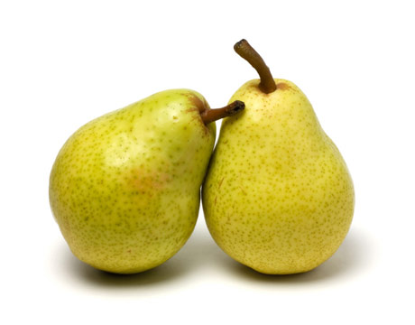
Pear Film World Corpus
Constraint and Freedom
John W. Du Bois
Linguistics
University of California, Santa Barbara

Slide 2
A comprehensive report?
1981 Wallace Chafe’s The Pear Stories is reviewed in Language:
"Readers who expect to find a comprehensive presentation of the results of the pear film project will be disappointed.” (Deborah Schiffrin)
2015 Still waiting for that final “comprehensive” report….
Notes:
All I can say is, we should all be thankful that Wally Chafe had the good sense to invite open-ended research, building on the tool provided by the Pear Film and the idea of the verbalization of experience. For

Slide 3
Where will it all end?
1975 Pear Film debut in Berkeley, California
1980 Chafe, Wallace L. (ed.) The pear stories: cognitive, cultural, and linguistic aspects of narrative production
1981 The Pear Stories is reviewed in Language
2015 Lots of new ideas, new findings—but nothing “final” or “comprehensive” yet!
fast forward to today
Notes:
All I can say is, we should all be thankful that Wally Chafe had the good sense to invite open-ended research, building on the tool provided by the Pear Film and the idea of the verbalization of experience. For

Slide 4
Overview
The Pear Film around the world
Constraint and freedom
Verbalization of experience
A case study: 3-participant events in Pear Film
Events in dynamic perspective
Pear Film World Corpus

Slide 5
Pear Film studies: 3 generations
1st generation (1970’s) | 2nd generation (1980’s) | 3rd generation (2000-now)
English K’iche’ Sakapultek Greek Japanese Haitian Creole Persian Malay Thai German | Finnish Hebrew English (children) Upper Sorbian Mandarin Cantonese Shanghai Wu Hakka Gan, Min, Xiang Spanish Basque | Belhare, Maithili, Nepali Russian Russian Sign Language Brazilian Sign Language Saliba, Logea Kosarek, Waima’a Taleshi, Hawrami Gurindji Kriol Akukem, Gants, Aruamu, Mum Cicipu, Avatime Meithei

Slide 6
Pear Film publications (1)
Wallace L. Chafe, ed. (1980). The pear stories: cognitive, cultural, and linguistic aspects of narrative production.
Wallace L. Chafe The deployment of consciousness in the production of a narrative.
Robert Bernardo Subjecthood and consciousness.
Patricia M. Clancy Referential choice in English and Japanese narrative discourse.
Pamela Downing Factors influencing lexical choice in narrative.
John W. Du Bois Beyond definiteness: the trace of identity in discourse.
Deborah Tannen A comparative analysis of oral narrative strategies: Athenian Greek and American English.

Slide 7
Pear Film publications (2)
Du Bois, John W. (1987). The discourse basis of ergativity.
Erbaugh, Mary S. (1990). Mandarin oral narratives compared with English: The Pear/Guava Stories.
Helasvuo, Marja-Liisa (1993). Are relative clauses either restrictive or non-restrictive? A study of relative clauses in the Finnish pear stories.
Chafe, Wallace L. (1994). Discourse, consciousness, and time: The flow and displacement of conscious experience in speaking and writing.

Slide 8
Pear Film publications (3)
Orero, Pilar (2008). Three different receptions of the same film: ‘The Pear Stories Project’ applied to audio description.
Blackwell, Sarah E. (2009). What’s in a pear film narrative? Framing and the power of expectation in Spanish.
McCleary, Leland E. & Viotti, Evani (2010). Sign-gesture symbiosis in Brazilian Sign Language narrative.
Vilaró, Anna, et al. (2012). How sound is the Pear Tree? Testing the effect of varying audio stimuli on visual attention distribution.
Mazur, I. & Kruger, J.L. (2012). Pear stories and audio description: Language, perception and cognition across cultures.
Lester, Nicholas (2013). Blazing the narrative path: Motion events and narrative structure in the English pear stories.
Chelliah, Shobhana Lakshmi (2013). Predicting reference form: A Pear Story Study of information status, thematic role and animacy in Meithei (Manipuri, Meiteiron).

Slide 9
Constraint & freedom
“The more constraints one imposes, the more one frees one’s self.” —Igor Stravinsky

Slide 10
Constraint Freedom
rules actions
conventions creativity
grammar discourse
paradigm choice
past future
experience verbalization
event interpretation
sequence order, group, chunk

Slide 11
Verbalization of experience

Slide 12
Verbalization of experience
starts from recalled experience & develops into interactive discourse
moves from pre-verbal to verbal
involves real-time decision-making processes
is not easy
is not deterministic
allows for many different solutions to the task
is shaped by the dynamics of the verbalization up to now

Slide 13
Unconformity between thought & language
"I had become interested in what I saw as an unconformity between thought, as it was organized by language, and total thought, which I saw as manifested not only in language but also in mental imagery and emotions.” (Chafe, 2002: 246)
Experience: mental imagery, emotions, etc.
Verbalization: putting (some of) it into language
Unconformity: a productive tension arising from the incomplete mapping between experience and verbalization

Slide 14
Events: Isolated or dynamic?

Slide 15
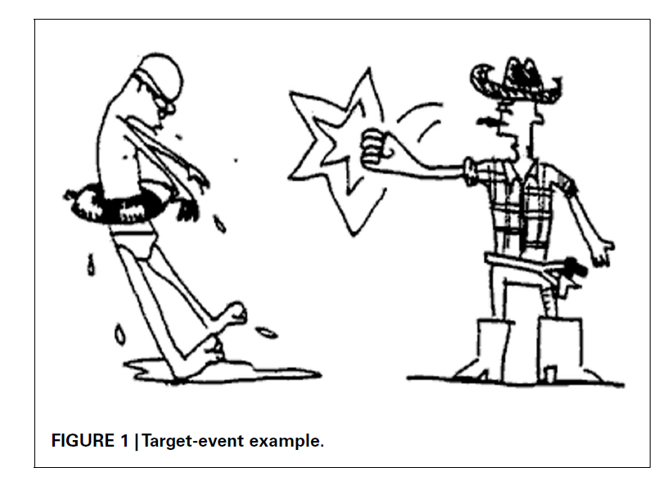
Isolated event: “transitive”
Notes:
Myachkov et al. 2012
Myachykov_et_al_2012_Referential_cues_Fig-1.png

Slide 16

Isolated event: “symmetrical”

Slide 17
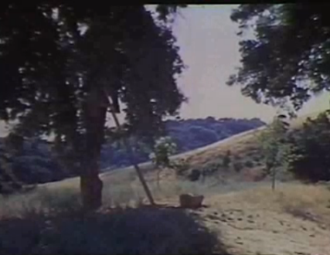
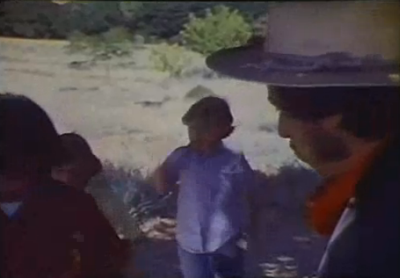
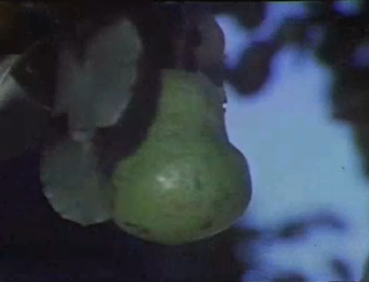
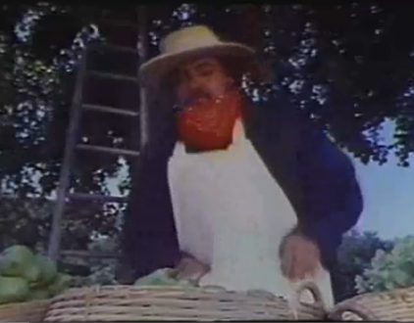
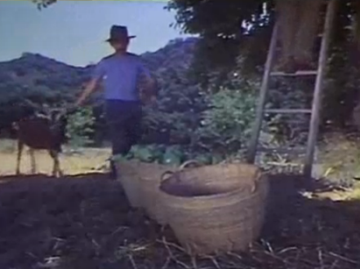
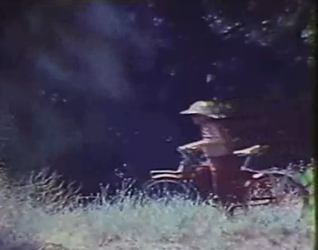
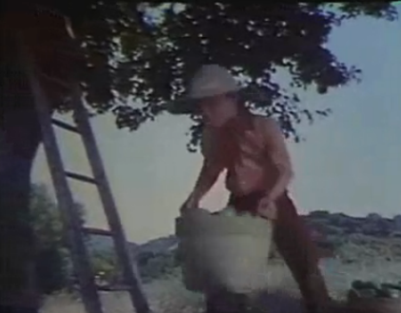
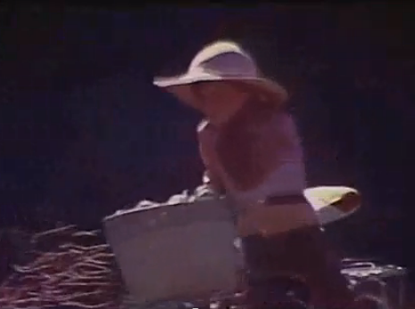
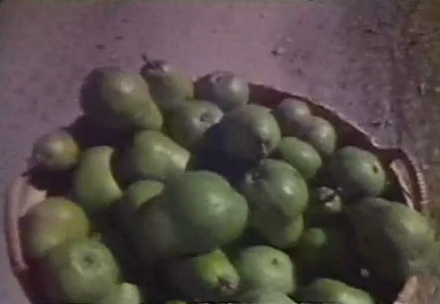
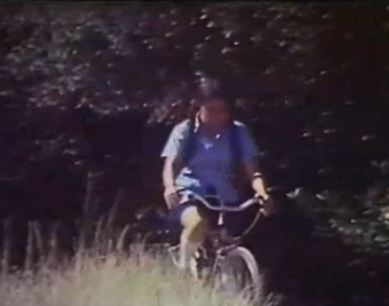
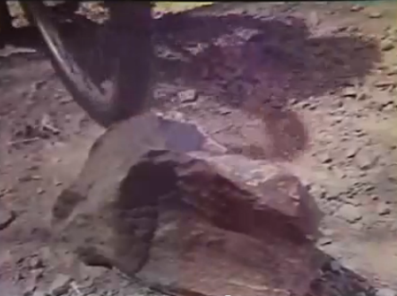
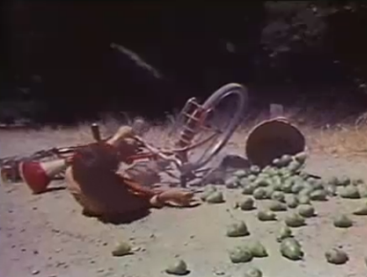
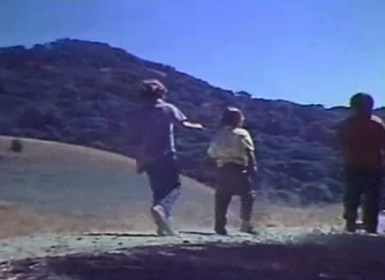
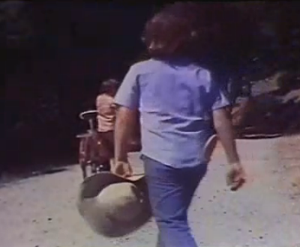
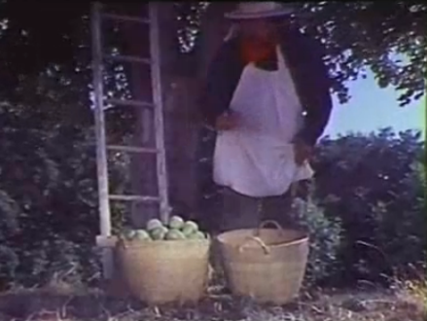
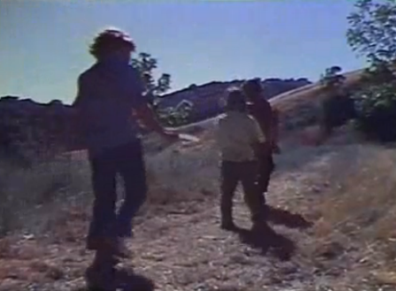
Events in continuous sequence
Basic experience: sequence of events, perspectives, dynamic interconnections, etc.
Time course of narrative

Slide 18
Carving out events
Verbalization transforms experience by carving out events, using argument structure constructions
Time course of narrative

Slide 19
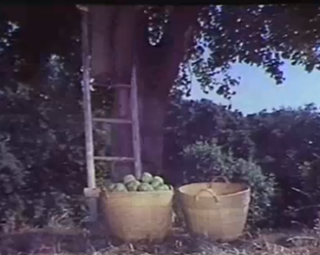
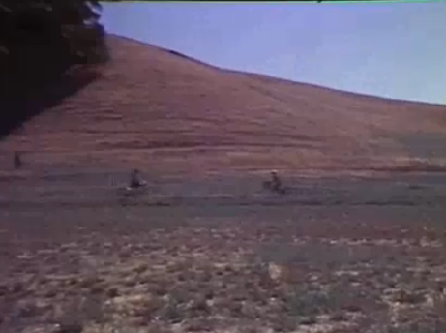
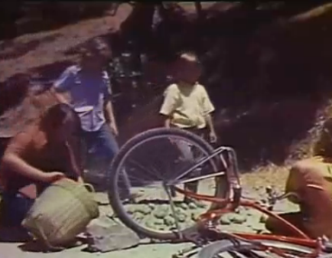
Events along the path
PEAR-PICKING
MEET
CRASH
Time course of narrative

Slide 20
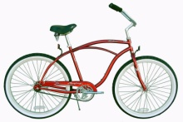

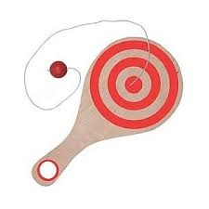
The narrative path (N. Lester)
Narrative as Source-Path-Goal schema
TREE
PATH
CRASH
Time course of narrative

Slide 21
Verbalizations vary
from one utterance to the next
from one speaker to the next
from one telling to the next
from one construction to the next
from one language to the next

Slide 22
Decisions for event verbalization
How is the event to be…
  delimited?
  interpreted?
  construed?
  categorized?
  profiled?
What participants are to be profiled as integral to the event?
What verb is to be selected?
What argument structure construction is to be selected?
What is the relation to verbalization of prior and subsequent events?

Slide 23
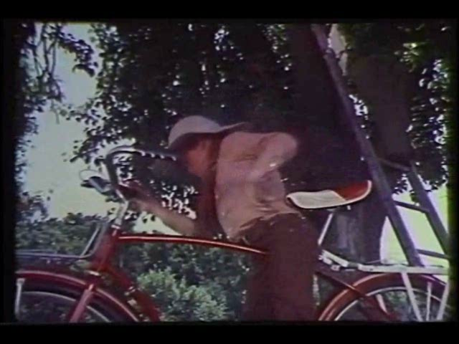
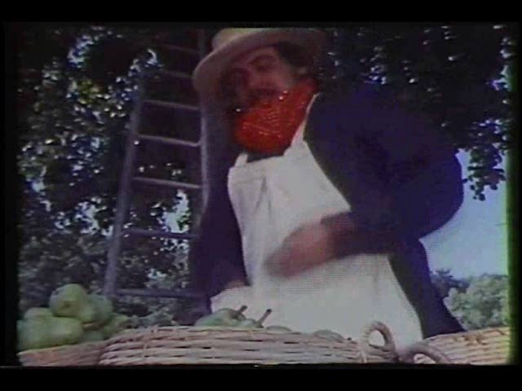
3-participant event: PUT
PUT [basket on bike]
PUT [pears in basket]
GIVE
PUT

Slide 24
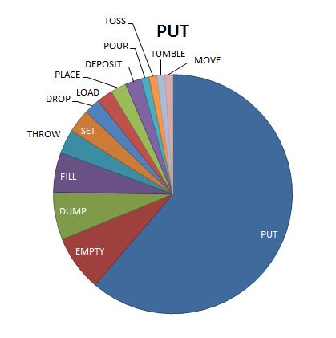
PUT event verbalizations in Pear Film

Slide 25
PUT: 2 different events
and I don't know how he does it,
but he puts the .. the big basket of pears on his bicycle, (S9)
The man climbed down out of the tree,
.. and put the pears in the basket, (S14)

Slide 26
One PUT event, many verbs
The man climbed down out of the tree,
.. and put the pears in the basket, (S14)
A:nd u:h and then he gets down out of the tree,
and he (0.3) dumps all his pears into the basket, (S1)
climbs down the ladder,
(0.8) and empties the pears .. into (0.6) big .. baskets. (S11)

Slide 27
Other put competitors
and Ø depositing them in three baskets,
that were down below.
And it shows him sort of tumbling them into a in a in a basket,
and they kind of toss them back into the basket,
and Ø places it in in the basket which is very full.

Slide 28
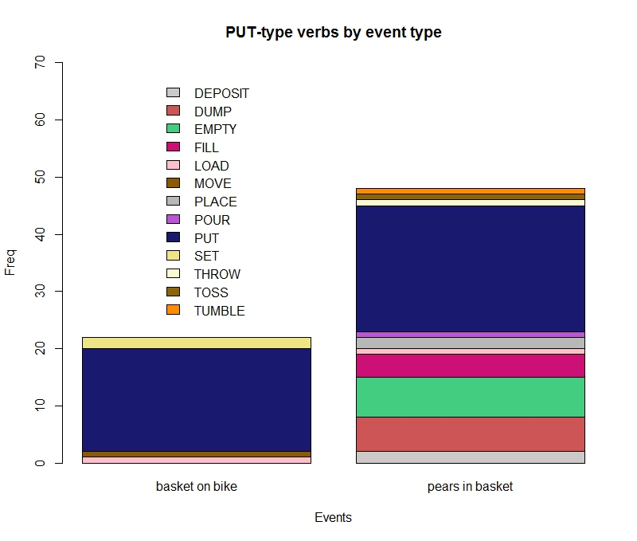
Different subtypes of PUT events

Slide 29
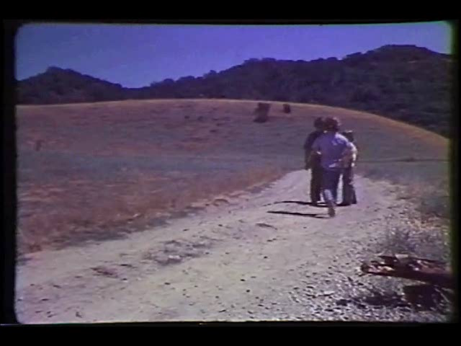
3-participant events: Social & non-social
Social event
(3-participant)
Non-social event
(3-participant)
GIVE
PUT

Slide 30
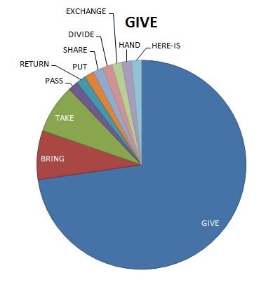
GIVE event verbalizations in Pear Film

Slide 31
Give competitors
and then he brings his hat to him,
and the g- guy on the bike gives the other kids
gives the kid that returns his hat .. three pears
to share with his buddies. (S1)

Slide 32
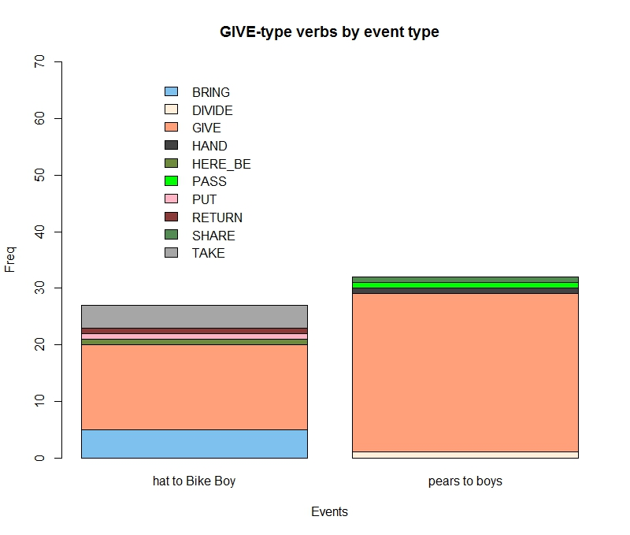
Different subtypes of GIVE events

Slide 33
Verbalizing GIVE events
(1.1) And he .. he comes back,
and gives him his hat, (S5)
CHOICE:
(1) … gives him his hat (S5)
(2) … gave it to the boy on the bicycle (S17)
(1) double-object ditransitive construction (give R T)
(2) prepositional object construction (give T to R)

Slide 34
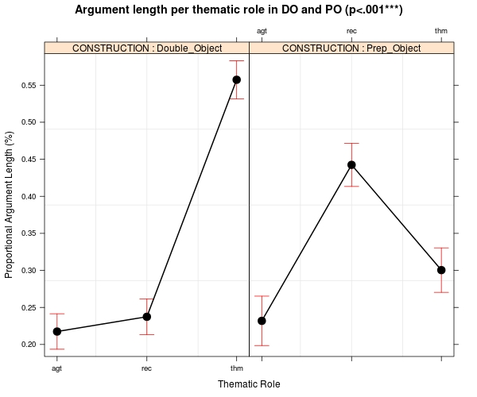

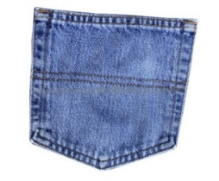
Twelve Principles of Functional Explanation
34
Argument length per role in Double Object
and Prepositional Object constructions (p<.001***)
A R T A R T
Role
Notes:
04_constructionXrole_sig.jpeg
Figure ASD: Interaction effect of constructional type (ditransitive double-object construction, left panel; prepositional object construction, right panel;) and thematic role on argument length
34

Slide 35
give + directional particle
double-object ditransitive +
directional particle (back)
… gives him his hat back (S3)
… gives him back his hat (S6)
… gives him back the hat (S18)

Slide 36
Transitive transfer: GIVE without give
… for bringing back his hat (S12)
… returns his hat (S1)
Transitive transfer codes the A and T directly.
But where’s the Recipient?
Not coded as a direct argument of the verb, but only as the possessor of the direct object (i.e. the theme his hat)

Slide 37
Transitive transfer: GIVE without a recipient
… brings the hat back (S7)
… bring the hat back (S2)
… for bringing back his hat (S12)
… goes back with the hat (S18)

Slide 38
Inference: The silent partner
and (0.3) one of the .. three boys brings the hat back,
(S7)
There is no overt expression of giving as such, but a transfer of the hat to its original owner is still communicated—by inference

Slide 39
‘Give’ & ‘put’ in Sakapultek Maya
Verbalizing without ditransitives

Slide 40
ya’ ‘put’
x- Ø- r- ya’ qaj p l chikech,
CP-3abs-3erg-put down at the basket
he put it in the basket,

Slide 41
ya’ ‘give’: Transitive transfer
i tik’ara’ x- Ø- aa- r- ya’ kan n pwe’,
and then CP-3abs-LAT-3erg-put remain that hat
and then he went and gave back that hat,

Slide 42
Compare English ‘bring back’ = ‘give’
i tik’ara’ x- Ø- aa- r- ya’ kan n pwe’,
and then CP-3abs-LAT-3erg-put remain that hat
and then he went and gave back that hat,
Cf. the minor pattern in English:
and (0.3) one of the .. three boys brings the hat back, (S7)

Slide 43
Social & non-social events in Sakapultek Maya
Social event
(3-participant)
Non-social event
(3-participant)
ya’
ya’

Slide 44
Constructions as verbalization strategies
Different languages grammaticize different solutions to the verbalization problem
Some languages offer ditransitive verbs and a double-object ditransitive construction (e.g. English)
Others have no ditransitive verbs or double-object ditransitive construction (e.g. Sakapultek Maya)

Slide 45
Conclusions
The verbalization of experienced events

Slide 46
Verbalization of events
Verbalization of events involves real-time processes that bring together:
  cognition
  communication
  constructions
Verbalization of events is the result of a dynamic, reciprocal interaction between recalled mental imagery, the online sequential selection of linguistic expressions, and monitoring of the dynamic circuit
We are just beginning to formulate ways of investigating verbalization as a dynamic process

Slide 47
Conclusions: Verbs & events
Are events inherently transitive, ditransitive, etc.?
Not necessarily
In Sakapultek, absence of a double-object ditransitive construction is linked to the grammar’s routine exploitation of the Transitive Transfer strategy
The Transitive Transfer strategy uses a 2 core arguments, and only implicates a 3rd participant (the Recipient)
  By using a directional particle
  By using a possessor-marking of the transferred entity (Theme)
What in English is an infrequent pattern of inference is grammaticized as a major pattern in Sakapultek Maya
Constructions are resources for dynamic event verbalization

Slide 48
Pear Film World Corpus

Slide 49
What’s next?
It’s up to you!
More languages
More experimental innovation
More collaboration
More cross-linguistic comparison
Pear Film World Corpus
Notes:
All I can say is, we should all be thankful that Wally Chafe had the good sense to invite open-ended research, building on the tool provided by the Pear Film and the idea of the verbalization of experience. For

Slide 50
Pear Film World Corpus: Goals
To gather as many Pear Film narrations as possible from around the world into a unified body of data
To establish a permanent archive of recordings, transcriptions, datasets, publications, and other materials associated with the Pear Film
To make the Pear Film World Corpus freely available to all (within limitations set by original researchers)
To provide computational tools for accessing and comparing data in the Pear Film World Corpus
To provide researchers with a new digitization of the Pear Film
To facilitate new research around the world, looking at new languages with new methods

Slide 51
Constraint Freedom
privately stored data Pear Film World Corpus
existing recordings new recordings
existing analyses new analyses
Pear Film methods innovative methods
Pear Film new framings, protocols

Slide 52
Pear Filmers, call home
Lots of researchers have used the Pear Film, in all kinds of ways
We’ve never asked before, but we’re asking now:
Please get in touch!
Let us know if you have collected Pear Film narrations
If you’re willing, please deposit copies of your recordings and transcriptions in the Pear Film World Corpus
We’ll take good care of them, and make them available for everyone to use
Spread the word! (and we will too)

Slide 53
Twelve Principles of Functional Explanation
53
Thanks to my collaborators…
Wallace L. Chafe
Patricia Clancy
Jacinto Mutas Lopez
Manuel Lancerio Gomez
Brendan Barnwell
Nicholas Lester
…and all the Pear Film contributors!

Slide 54
Thank you!

